Slide 1
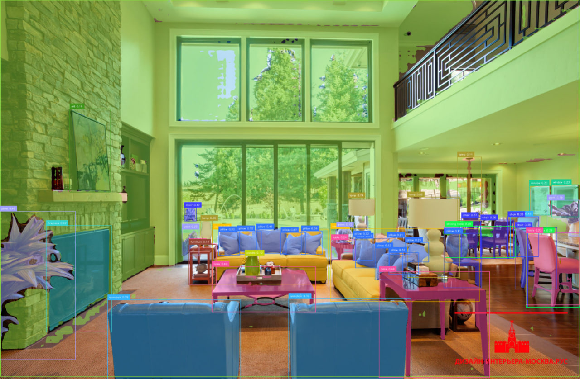
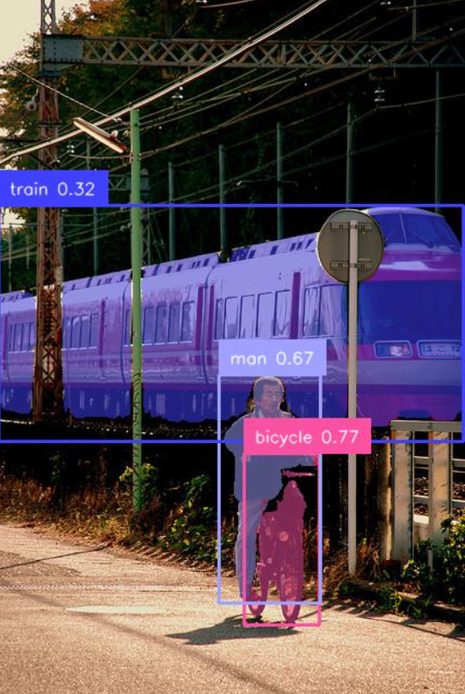
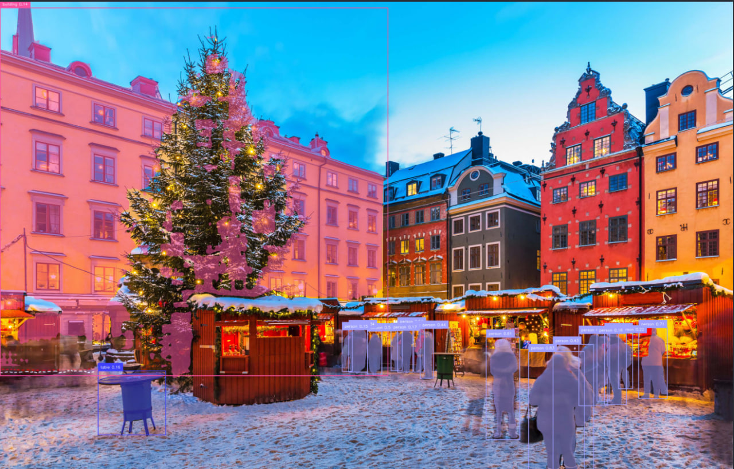
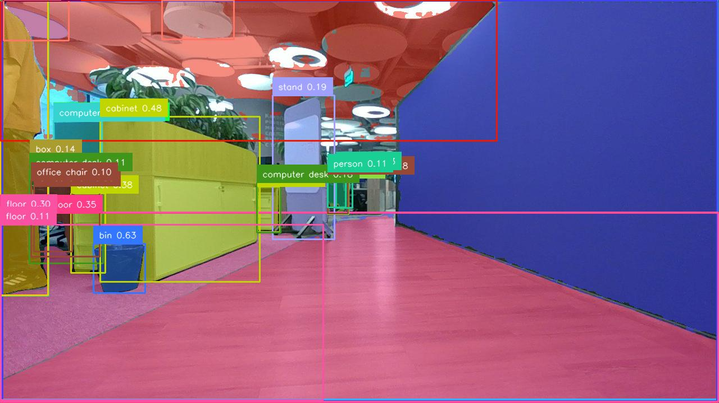
Scene Graph Construction
Andryushenko Solomon, MIPT
Cognitive Modeling, 2025

Slide 2
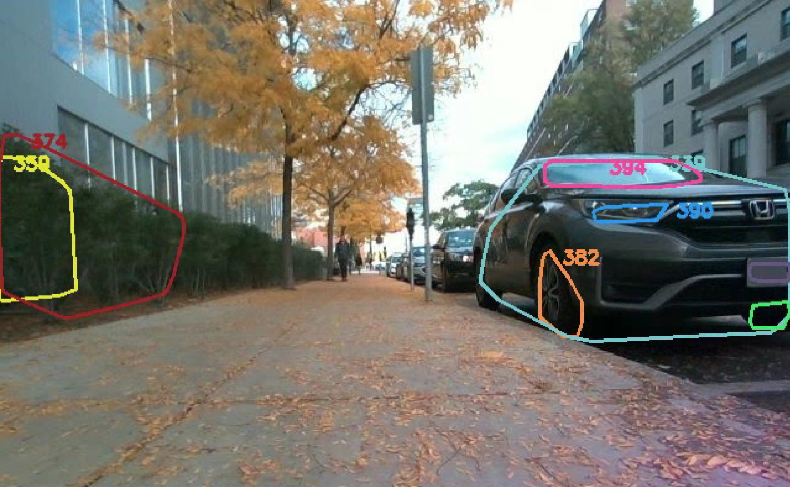
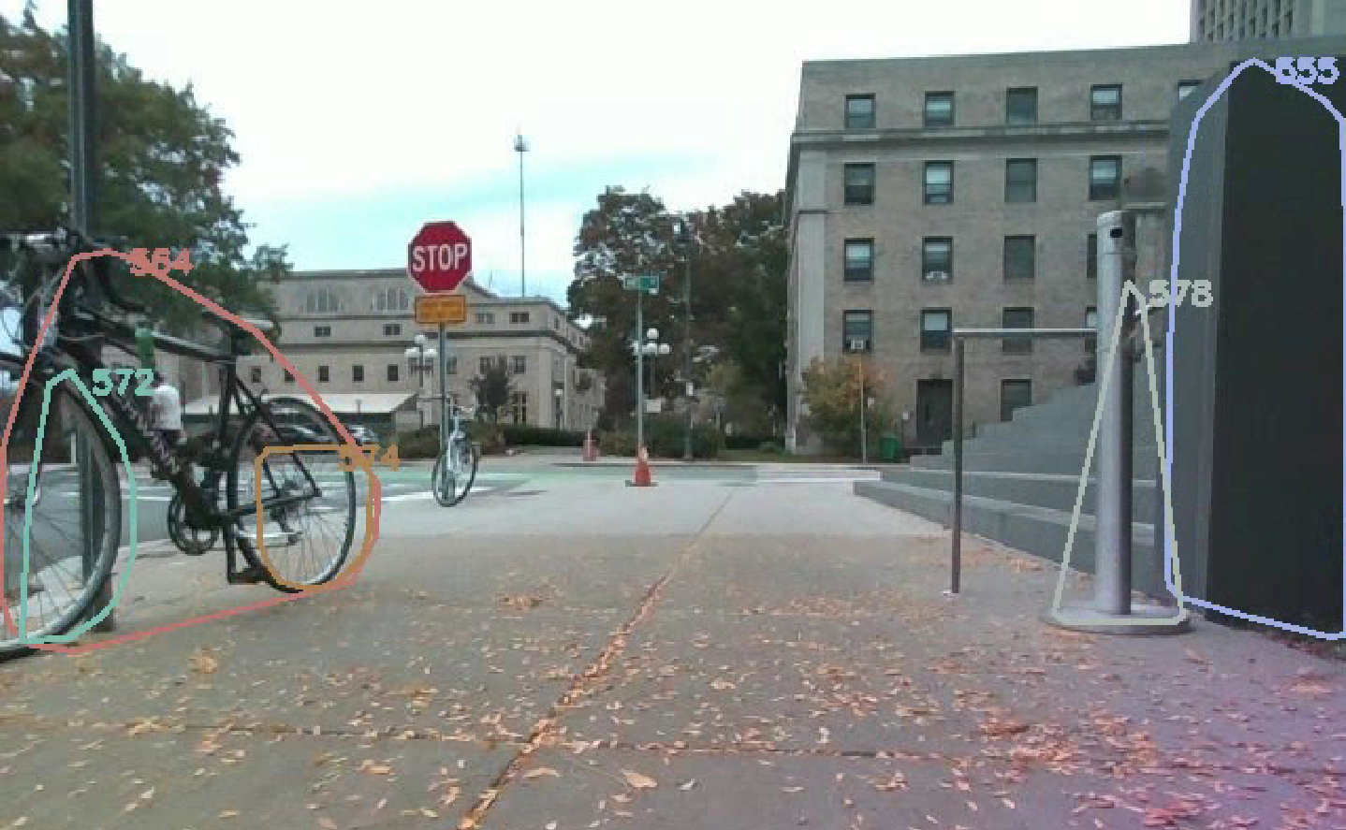
Roman
Launched on the prebuilt dataset in a docker container.

Slide 3

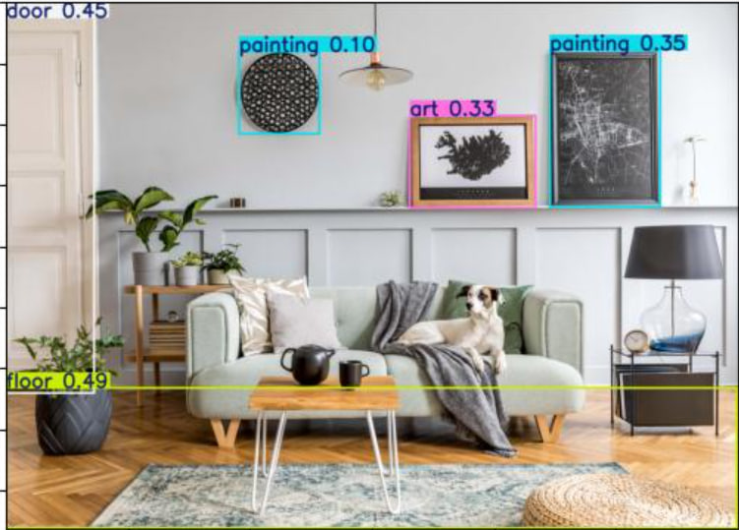
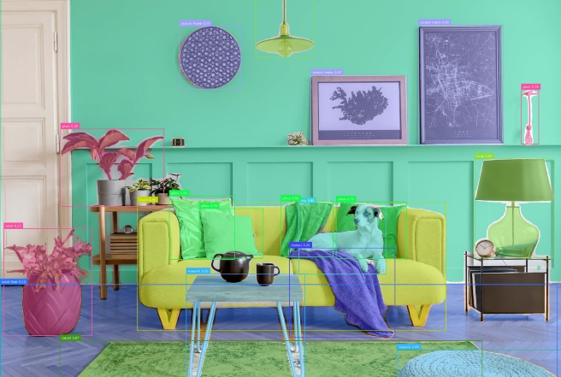

Ram++ & YOLO & Mobile-SAM-v2 pipeline
Created a full pipeline.
YOLO
MSAM
Couch, dog, painting, dining table, …
RAM++

Slide 4
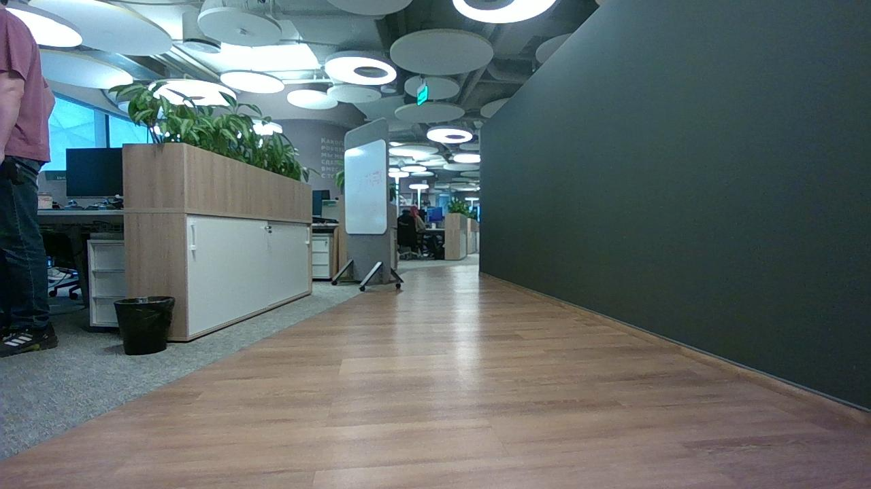
Sber Dataset
Made a run on a new sber dataset (780 RGBD images) using Rerun.io
Forwarded the results to a teammate.

Slide 5
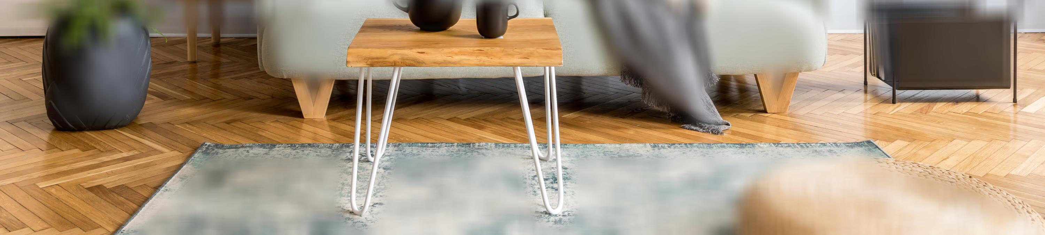
Graph Construction
Finding objects with “touching” masks.
Blurring / Cutting the initial image for each two masks.
Generating CLIP embeddings.
Find a place with a dining table on the floor.

Slide 6
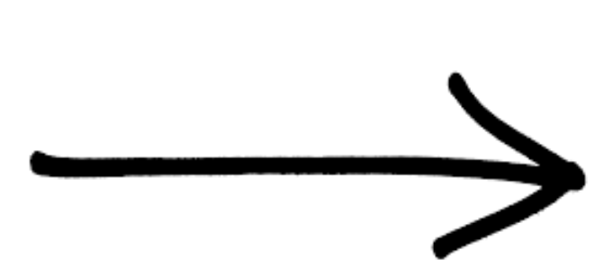
Query Graph
Finds objects and relations between them in a query.
Builds a graph.
Find a place where were 3 men and one of them was holding a cup.
Man
Cup
Place
Man
Man

Slide 7
Thank you for your attention

